Slide 1
3D SCANNER PROGRESS REPORT
Group 15: Nelson Wang, Allan Wang, Su Teh, Michael Hwang, Adrian Tabula

Slide 2
Completed Work
All stepper motors purchased and programmed successfully – ready for testing and implementation
CAD layout designed
Major subassemblies have been completed
Still requires design of base piece to bring together all subassemblies
Turntable mostly complete
Gears have been design and prototypes fabricated using laser cutter with cardboard (real gears will use plastics)
Hardware acquired : lazy Susan gear, plastics for surface, and base
IR scanner vertical actuator
IR sensor purchased and programmed; needs additional ADC
Hardware acquired: screw with thread-to-5mm coupler, long screw (needs to be cut), various hardware

Slide 3
Future Assignments
Complete and combine both turntable and IR scanner into a working assembly
Reduce sensor noise/increase sensor accuracy
Design and build the base
Program scanning phase
Write program to convert point cloud into STL or STEP file
Develop GUI

Slide 4
Challenges
Stepper motor timing needs to be examined – see if there’s any drift in motor position
Arduino ADC not sufficient enough for the IR sensor (too low resolution)
Array of IR sensors to make the scan time shorter
Possibility of using ultrasonic sensor?
Hard to test software without the entire system working

Slide 5
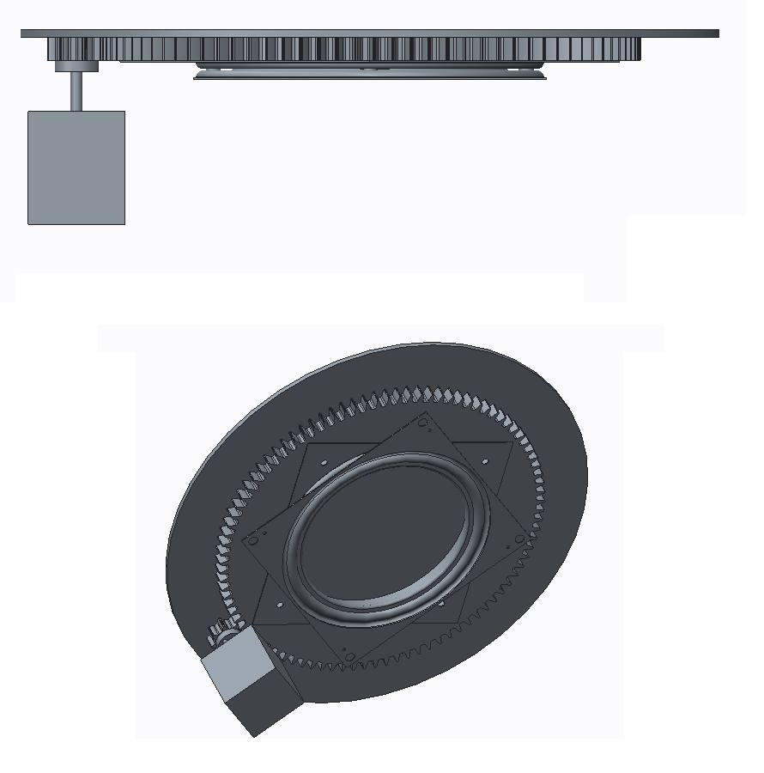
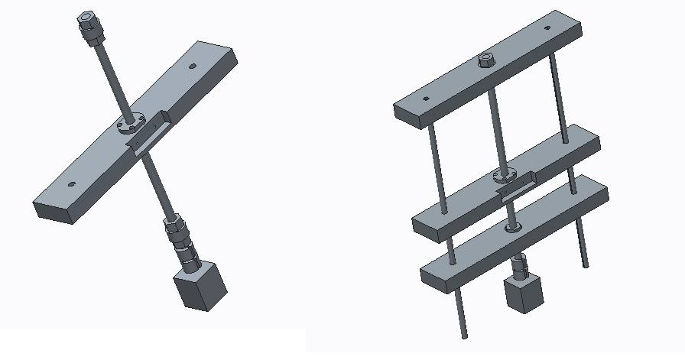
CAD Models

